Slide 1


Technical Project Management - 670
Project Kickoff Presentation
Trade Mate
Share, Rent, Save – Build a Sustainable Community Together!
Group 2
Kishan, Nithesh, Pragathi, Siddarth. Shrija, Thanuja
PRESENTED TO
DATE OF PRESENTATION
Prof. Nehal Patel
December 8, 2024

Slide 2

AGENDA
Project Scope and Objectives Work Break Down Structure Cost Breakdown Structure Resource Management Key Milestones Critical Path Recovery Strategy Risk Management and Mitigation Conclusion

Slide 3

PROJECT SCOPE AND OBJECTIVES
A mobile application designed to facilitate buying, renting, and lending of everyday items, fostering a culture of resource sharing and sustainable living within local communities.
Scope
Platform
Mobile application available
on iOS and Android.
Objectives
Facilitate Affordability: Provide an economical option for obtaining essential items.
Promote Sustainability: Encourage resource sharing to reduce waste and environmental impact.
Build Community: Create a trusted, collaborative network of users through a transparent platform.
Enhance User Convenience: Offer a seamless experience with easy navigation and reliable tools.
Core Functions
Buying, renting, and lending everyday items.
Target Audience
Primary: International students
Secondary: Local families and individuals

Slide 4



WHY TRADEMATE?
Problem Overview
Lack of convenient and reliable platforms for item rentals and purchases tailored to the needs of international students and local families.
Existing solutions are either too complex, expensive, or fail to address the diverse requirements of these communities.
Challenges
Accessibility:
Difficulty in finding platforms with intuitive navigation and localized features.
Trust:
Limited transparency in
item quality, user
reviews, and security
of transactions.
Solution
Create a seamless, secure, and cost-effective platform that simplifies item rentals and purchases with features like user-friendly filters, secure payments, and community-driven reviews.
.
Affordability:
High costs associated with existing rental/purchase options.
Efficiency:
Time-consuming processes
for listing, searching,
and purchasing items

Slide 5






PROJECT OVERVIEW
Deliverables
Project Duration
Key Milestones
Dollar Cost
Risk
112 days
1st Jan 2025
to
1st May 2025
Home Screen
Navigation feature
Messaging Feature
Notifications feature
Cart feature
Payment feature
Settings
Testing
Total Estimated cost:
$120,000
Used : $95,168
Back-Up : $24,832
Login Team
Security Team
Backend Team
Checkout Team
Payments Team
Search Team
Navigation Team
Messaging Team
A fully functional mobile application

Slide 6
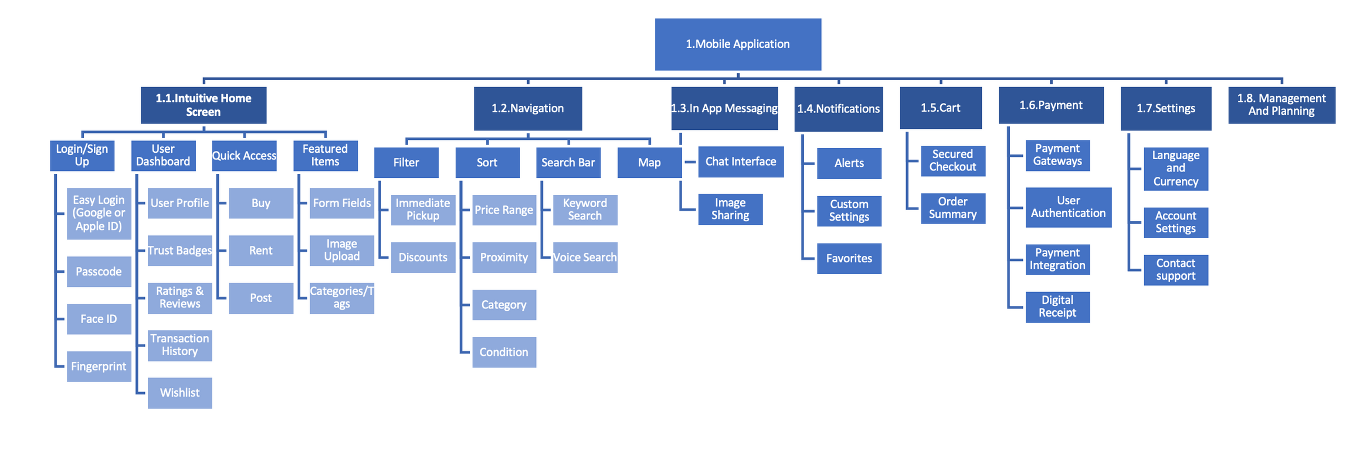
WORK BREAKDOWN STRUCTURE

Slide 7
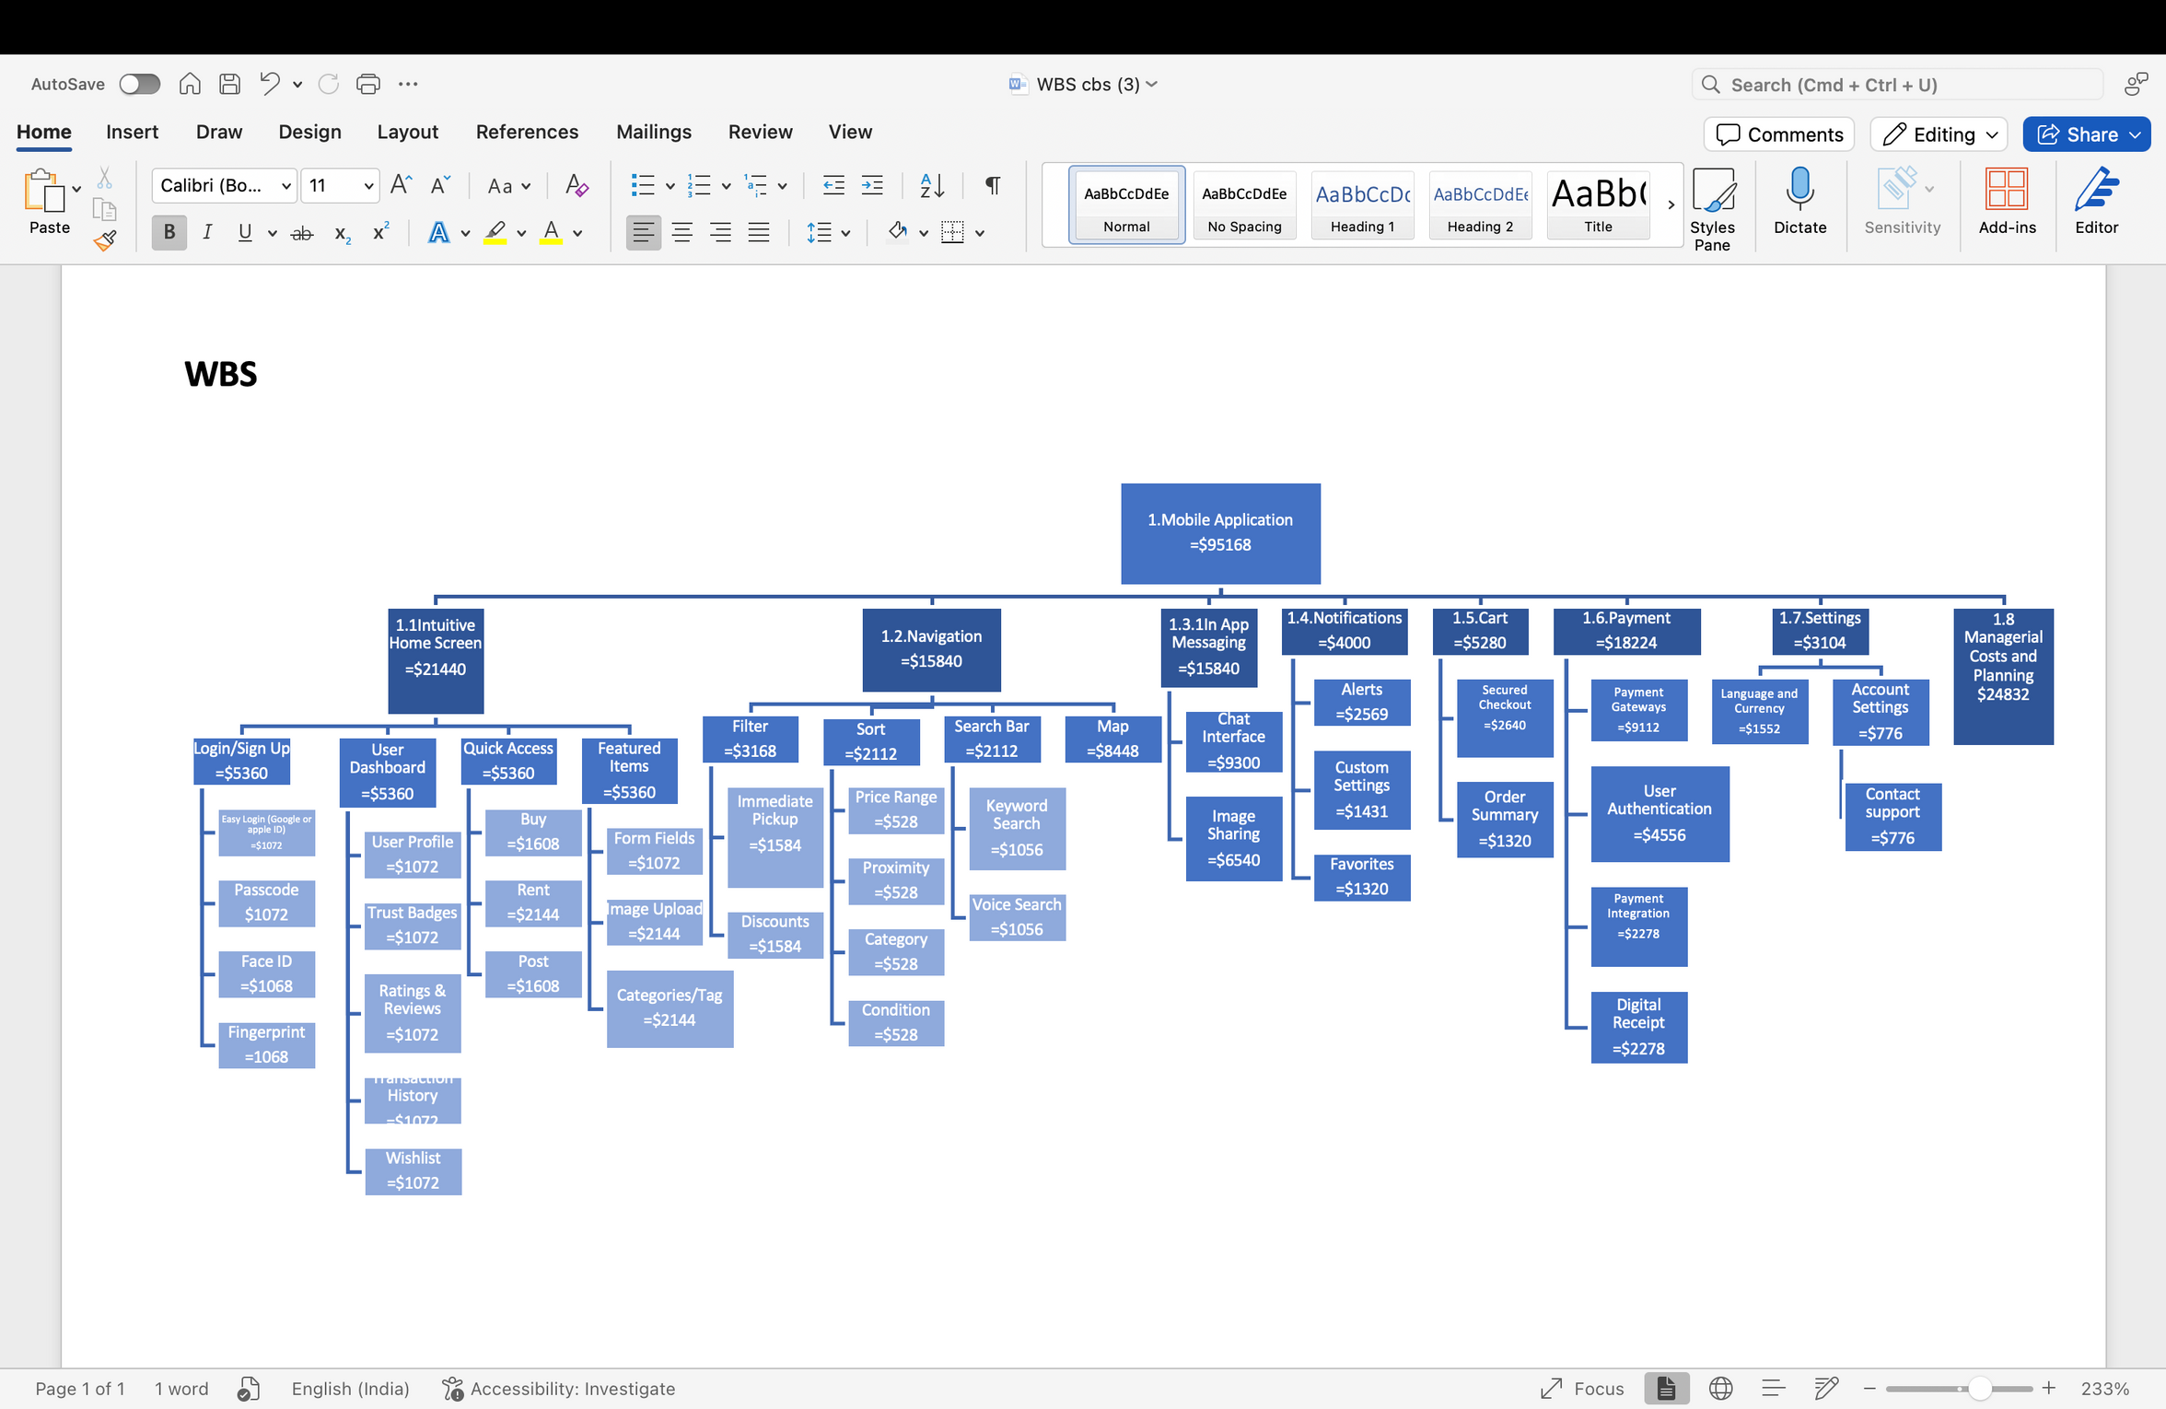
COST BREAKDOWN STRUCTURE

Slide 8
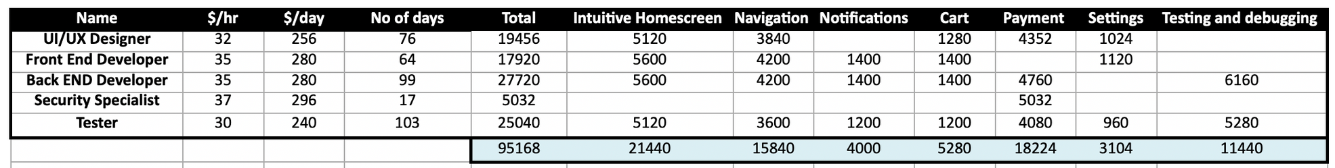
RESOURCE MANAGEMENT

Slide 9
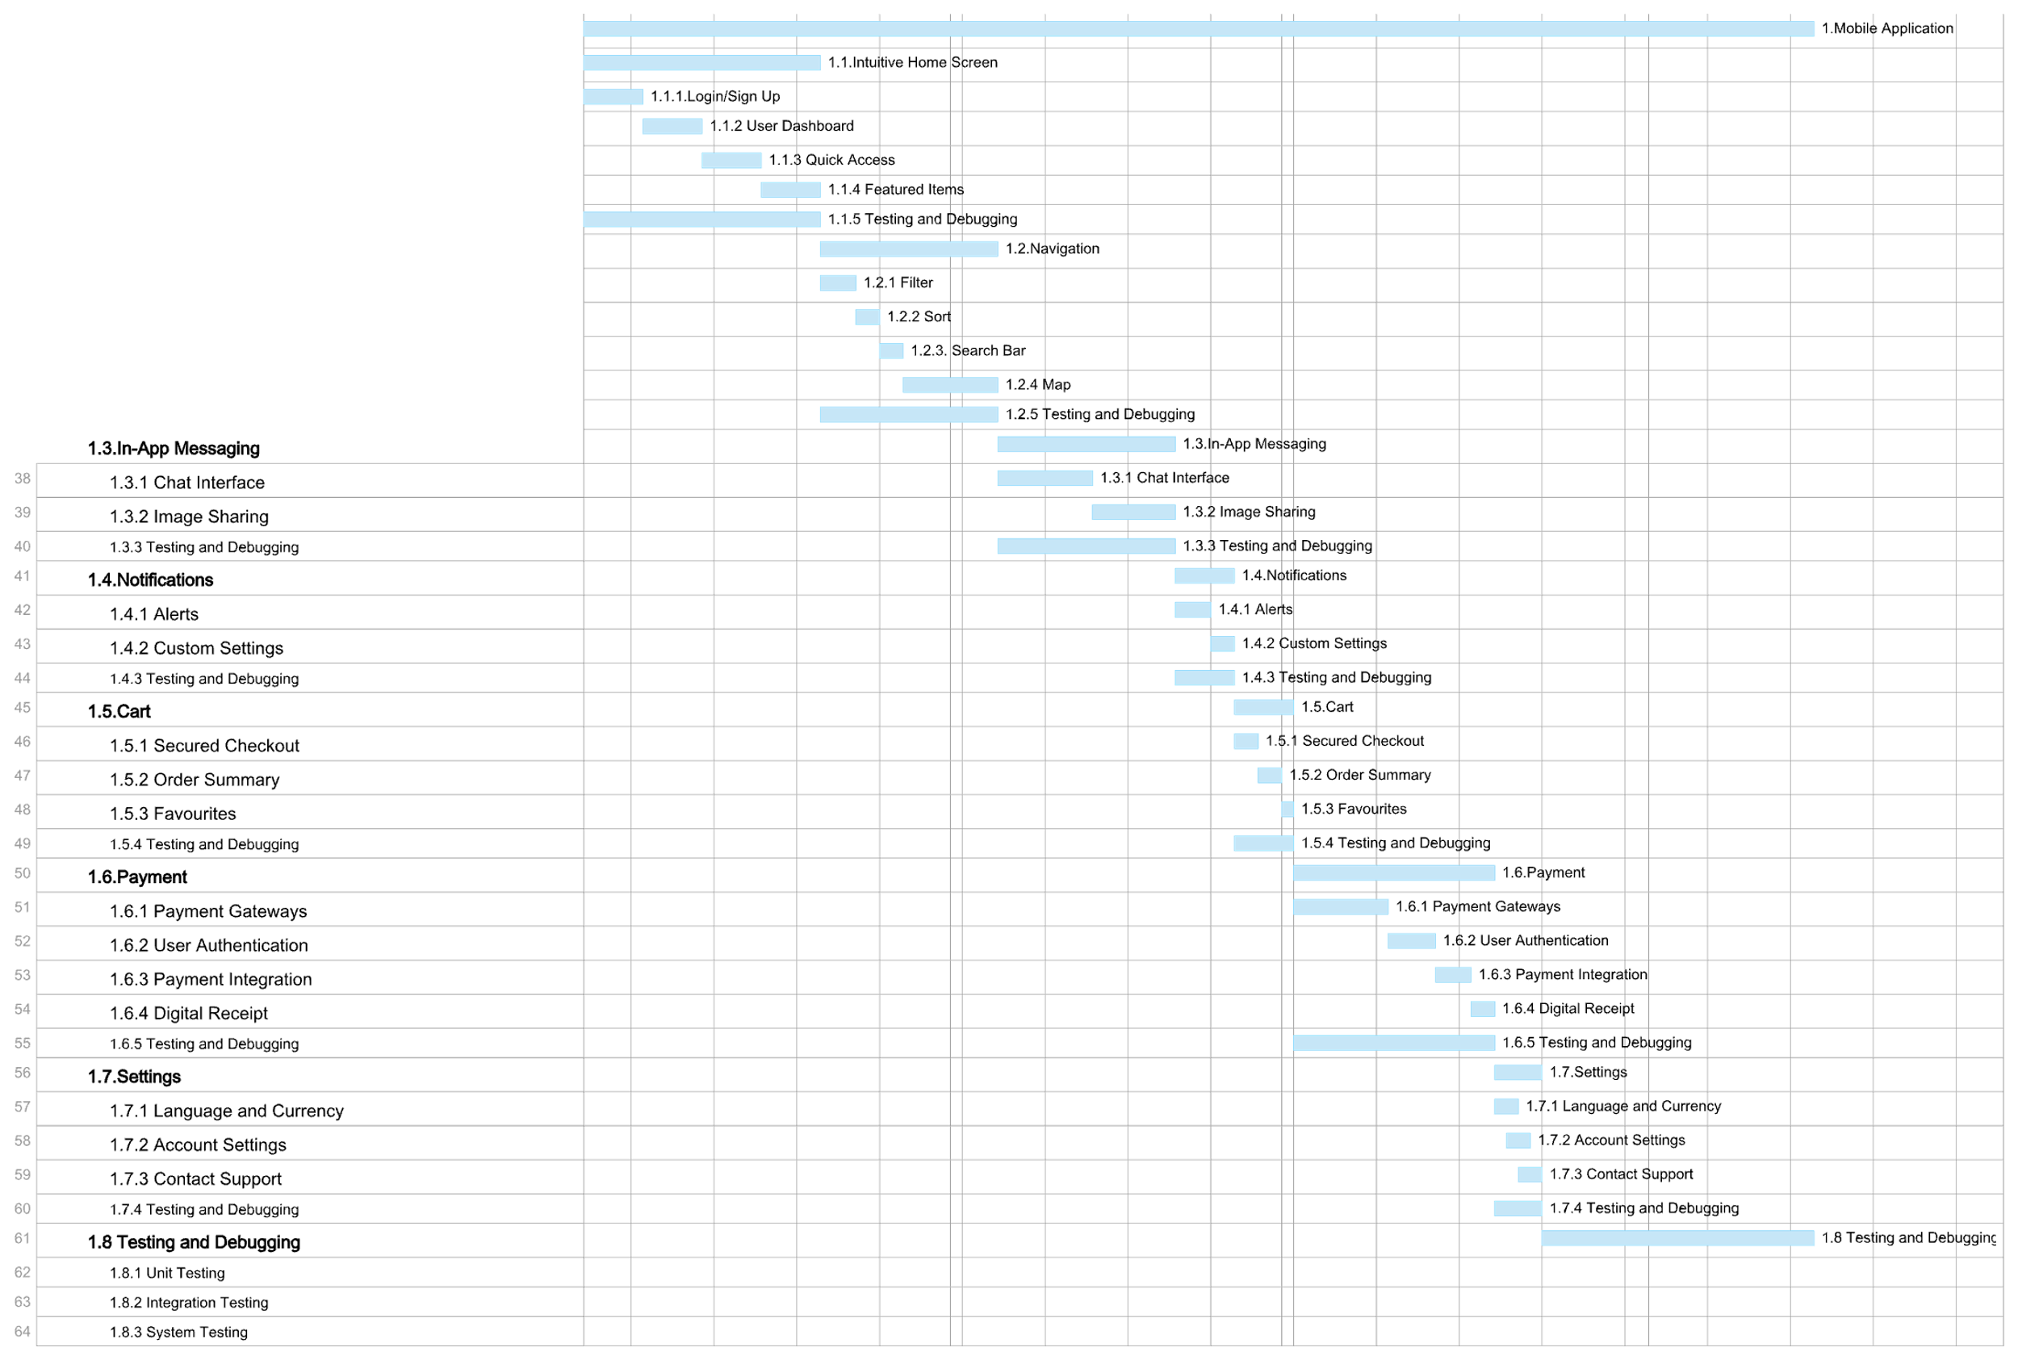
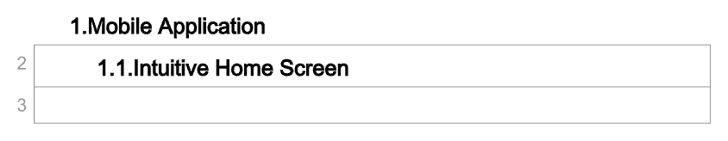
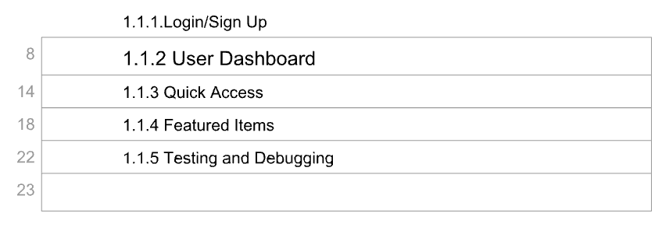

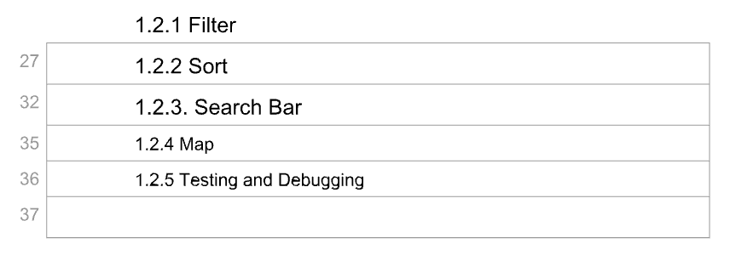
PROJECT SCHEDULE

Slide 10
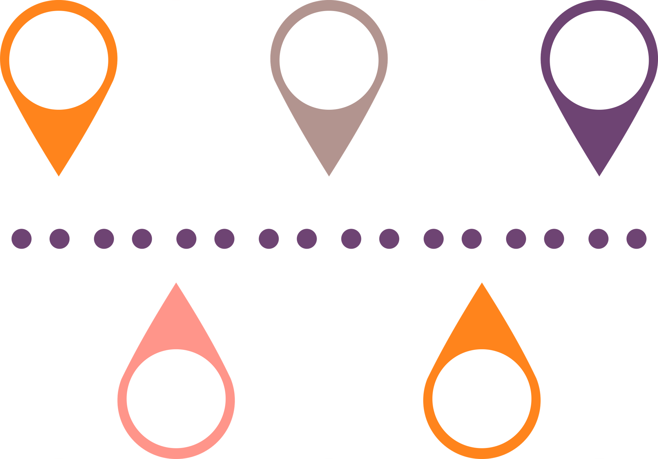

KEY MILESTONES
Day 20
1/20/25
Day 50
2/19/25
Day 60
3/1/25
Day 84
3/22/25
Navigation
Notifications feature
Payment
Testing
Home Screen
Messaging Feature
Cart
Settings
PROJECT LAUNCH
Day 112
5/1/25
Day 35
2/4/25
Day 55
2/24/25
Day 80
3/17/25
Day 103
4/14/25

Slide 11
Task ID | Task Name | Duration (Days) | Start Date | End Date
1.1 | Intuitive Home Screen | 20 | 01-Jan-2025 | 20-Jan-2025
1.2 | Navigation Features | 15 | 21-Jan-2025 | 04-Feb-2025
1.3 | In-App Messaging | 15 | 05-Feb-2025 | 19-Feb-2025
1.4 | Notifications | 5 | 20-Feb-2025 | 24-Feb-2025
1.5 | Cart Development | 5 | 25-Feb-2025 | 01-Mar-2025
1.6 | Payment Integration | 15 | 02-Mar-2025 | 17-Mar-2025
1.7 | Settings | 5 | 18-Mar-2025 | 22-Mar-2025
1.8 | Testing and Debugging | 23 | 23-Mar-2025 | 14-Apr-2025
Total | Total | 103 | 01-Jan-2025 | 14-Apr-2025
CRITICAL PATH ANALYSIS
1.4.Notifications
1.1.Intuitive Home Screen
1.2.Navigation Feature
1.3.In-App Messaging
1.5.Cart Development
1.6.Payment Integration
1.7.Settings
1.8.Testing and Debugging

Slide 12
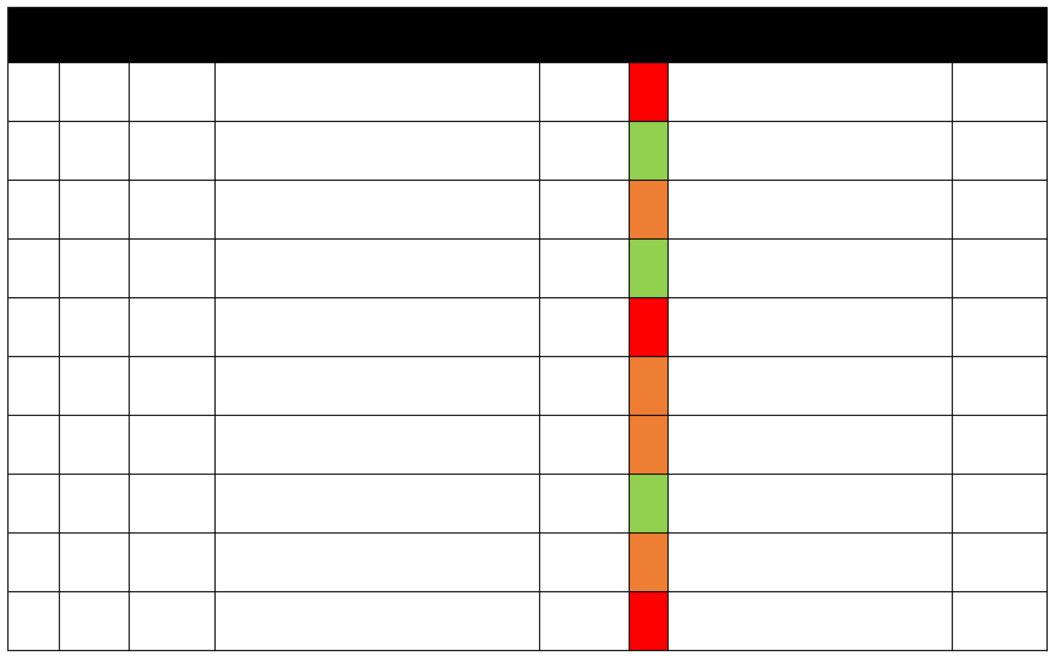
RISK MANAGEMENT
Risk IDOwner
Type
Risk Identification (If Then)
Likelihood &
L*C
Mitigation Strategy for CSP
Task Start Date
Consequence Score
1
Login Team
Security
If OAuth fails, then users cannot log in. Potential loss of user engagement may require additional budget for debugging and re-testing.
If encryption is weak, then data leaks occur. Data leaks could
result in fines, loss of reputation, and additional time for
security upgrades.
If data sync fails, then users see incorrect history. Delays in
transaction history synchronization can disrupt operations
and customer satisfaction.
If checkout is complex, then users abandon cart. Revenue
loss due to uncompleted transactions and time spent
optimizing checkout flow.
If gateway fails, then payments are disrupted. Transaction
disruptions may lead to loss of sales, extended downtimes,
and operational delays.
If filter logic fails, then users cannot find relevant items. User
dissatisfaction due to unusable filters may result in redesign
costs and development delays.
If sorting logic is unclear, then users face confusion.
Confusing sorting logic impacts usability, leading to rework
on user interface design.
If search indexing is poor, then users see irrelevant results.
Irrelevant search results can reduce engagement and
necessitate updates to the search
If APIs fail, then map features won't work. Incorrect
locations or delivery zones due to API failures could lead to
logistical issues and user frustration.
If chat backend crashes, then communication is disrupted.
Chat crashes can disrupt transactions, requiring scaling of
infrastructure and reconfiguration.
L5, C3
15
Allocate budget for robust login testing, fallback mechanisms, and OAuth redundancy.
1-J an-25
2
Security Team
Security
L1, C5
5
Ensure encryption upgrades and regular security audits to prevent fines and improve reliability.
21 -Jan-2 5
3
Backend Team
Data
L2, C3
6
Automate synchronization workflows to reduce delays and ensure customer trust.
5-Feb-25
4
Checkout Team
Usability
L2, C2
4
Simplify checkout processes and provide reminders to reduce abandonment rates and revenue loss.
20 -F eb-25
5
Payments Team
Financial
L4, C5
20
Implement backup gateways and retry mechanisms to prevent downtime and maintain performance.
6-Mar-25
6
Search Team
Functionality
L2, C3
6
Optimize and test filters thoroughly to ensure functionality and usability without rework.
21 -Jan-2 5
7
Search Team
Functionality
L3, C3
9
Test sorting logic rigorously to avoid confusion and ensure interface clarity.
5-Feb-25
8
Search Team
Functionality
L2, C2
4
Enhance AI-powered search and smart suggestions to improve user satisfaction and retention.
21 -M ar-2 5
9
Navigation Team
Functionality
L2, C4
8
Use backup APIs and validate location inputs to avoid logistical inefficiencies.
28 -M ar-2 5
10
Messaging Team
Performance
L3, C5
15
Scale backend infrastructure dynamically to avoid crashes and improve system reliability.
17 -Ap r-2 5

Slide 13
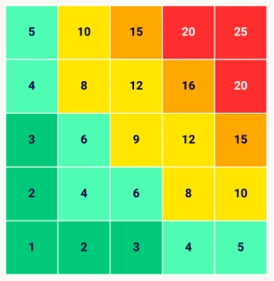
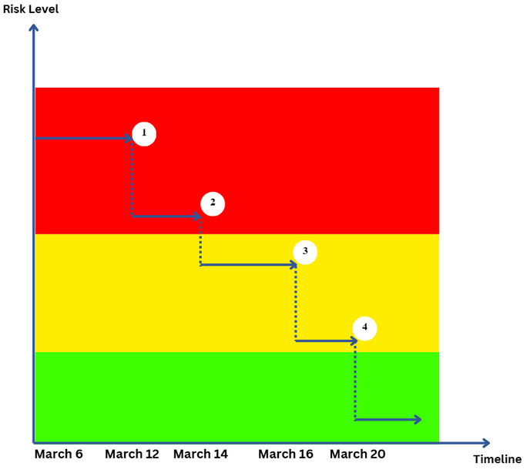
RISK MONITORING
Payment Failures
If OAuth fails, then users cannot log in. Potential loss of user engagement may require additional budget for debugging and re-testing.
Multiple Payment Gateways: Integrate backup gateways like Stripe and PayPal alongside the primary payment processor.
Retry Mechanisms: Implement automated retry logic for failed payments, ensuring a seamless user experience.
Monitoring and Alerts: Continuously monitor gateway uptime and set up real-time alerts for payment gateway downtimes to expedite resolution.
Secure Payment Flows: Use robust encryption and tokenization for secure handling of payment data. Regularly update compliance with industry standards such as PCI DSS.

Slide 14

RECOVERY STRATEGY
GENERAL RECOVERY STRATEGIES
1.Assess the Problem 2.Revisit Plans 3. Communicate Transparently 4.Implement Quick Fixes 5.Monitor Progress 6.Learn and Prevent.
SCENARIO
Payment Gateway Integration delayed due to API bugs and lack of a dedicated testing environment.
IMPACT
Critical delay of 3 weeks, risking the MVP launch timeline.
SOLUTION
Assess: Analyze API issues and identify key blockers in the integration process.
Reallocate Resources: Assign one backend and one frontend developer to focus solely on payment integration. Hire a payment API consultant for expert guidance.
Optimize Workflow: Set up a sandbox testing environment to simulate payment flows and troubleshoot API bugs effectively. Break the integration into smaller, trackable tasks like card processing, validation, and transaction recording.
Track Progress: Conduct twice-weekly progress reviews and monitor key metrics like bug resolution rates and milestone completions.
Deprioritize Non-Critical Features: Move low-priority tasks like "Favorites" or advanced filtering to post-MVP updates to free up development time.
OUTCOME
Secure Payment Gateway Integration completed within 2 weeks of the revised timeline. The MVP launched on schedule, ensuring a seamless and secure user payment experience.

Slide 15

CONCLUSIONS
Develop a tech-driven platform to enhance operational efficiency, sustainability, and customer experiences in thrift shopping.
Proposed Features:
User Engagement: Secure checkout, image sharing for item previews.
Operational Efficiency: Streamlined inventory management and optimized receipt processing systems.
System Enhancements:
Improved reliability through server scaling and API updates.
Integration upgrades for smoother functionality and future scalability.
Strategic Approach:
Emphasis on robust testing and detailed contingency planning.
Structured project management with a comprehensive Work Breakdown Structure (WBS) and risk mitigation strategies.
Future Focus:
Integration of real-time monitoring and scalable systems to address challenges proactively and support growth.

